Slide 1
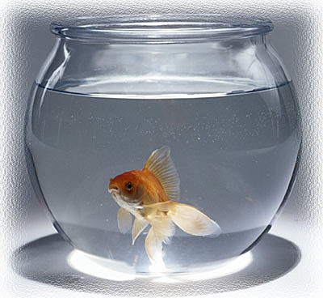
Fluid Statics

Slide 2
Outline
Basic equation of fluid statics
Standard atmosphere
Pressure variation in a static fluid
Hydrostatic force on submerged surfaces
Buoyancy and stability

Slide 3
Fluid statics/Hydrostatics
Stationary fluid
Fluid particle retains its identity for all times and fluid elements do not deform
Pressure
Pressure is defined as the amount of force exerted on a unit area of a substance
Important phenomenon in many practical applications

Slide 4
Basic equation of fluid statics
Objective – To obtain an equation to compute pressure field in a static fluid
Differential fluid element (mass=‘dm’, volume= ‘dV’ (dx.dy.dz))
Forces applied
Body forces
Surface forces
Newton’s second law of motion

Slide 5
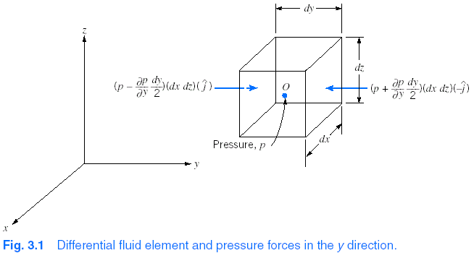


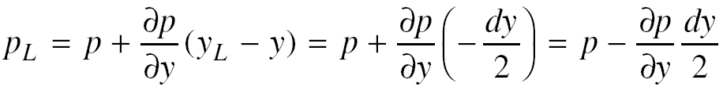
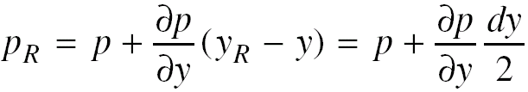
Basic equation of fluid statics
Body forces
Surface forces
Pressure (p(x,y,z))→ p at point ‘O’

Slide 6
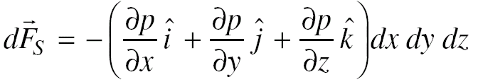
Basic equation of fluid statics
Pressure forces
Magnitude of the pressure
Area of the face (to give magnitude of pressure force)
Unit vector to indicate the direction
Pressure gradient
Change of pressure with distance

Slide 7


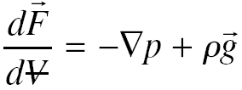
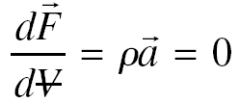

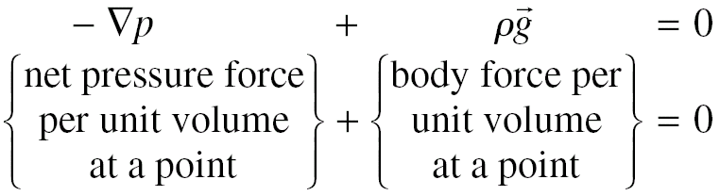
Basic equation of fluid statics
Total force
Newton’s second law (static fluid)

Slide 8

Basic equation of fluid statics
If ‘z-axis’ is directed vertically upwards
g_{x} = g_{y} = 0; g_{z}= -g;
Pressure – height relation
Assumptions / restrictions
Static fluid
Gravity is the only body force
z-axis is vertically upward

Slide 9
Pressure
Absolute pressure: The pressure of a fluid is expressed relative to that of vacuum (=0)
Gauge pressure: Pressure expressed as the difference between the absolute pressure of the fluid and that of the surrounding atmosphere.

Slide 10
Standard Atmosphere
US standard atmosphere at sea level
T = 15 C (288.15 K)
P = 1 atm (101.325 kPa)
Density = 1.225 kg/m³
Specific weight = 12.014 N/m³
Viscosity = 1.789 e-5 N.s/m²

Slide 11
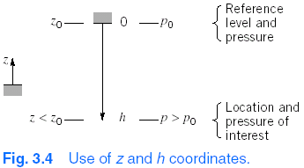


Pressure variation in a static fluid
Incompressible fluid
Density (ρ) = constant
Pressure difference between two points can be determined by measuring elevation difference
Devices → Manometers

Slide 12
Measurement of pressure
Barometers (Mercury)
To measure atmospheric pressure
Piezometer tube
Simplest type of manometer (used to measure pressure higher than atmospheric and relatively small pressures)
U-tube manometer
Simple and inexpensive device to measure pressure

Slide 13
Examples
Because of leak in a buried gasoline storage tank, water has seeped in to the depth as shown in Fig. SG is 0.68. Determine the pressure at the interface and at the bottom of the tank
By modeling sphygmomanometer as a U-tube manometer, convert normal blood pressure (120/80 mm Hg) to kPa (gage)
5.2 m
gasoline
water
0.9 m

Slide 14
Sensitivity of a manometer
It is a measure of how sensitive a particular manometer is compared to a simple water filled U-tube manometer
OR
Ratio of deflection of manometer to that of a water filled U-tube manometer, due to same applied pressure difference
Sensitivity can be increased by
Using less denser fluid
Changing manometer design
By using two immiscible liquids (of slightly different density)

Slide 15
Multiple-liquid manometer
Rules of thumb for analysis of multiple-liquid manometer
Two points at same level in a continuous single fluid have same pressure.
Neglect change in pressure with depth for a gas (as (density )_{gas} << (density)_{liquid}
Pressure increases as one goes down a liquid column

Slide 16
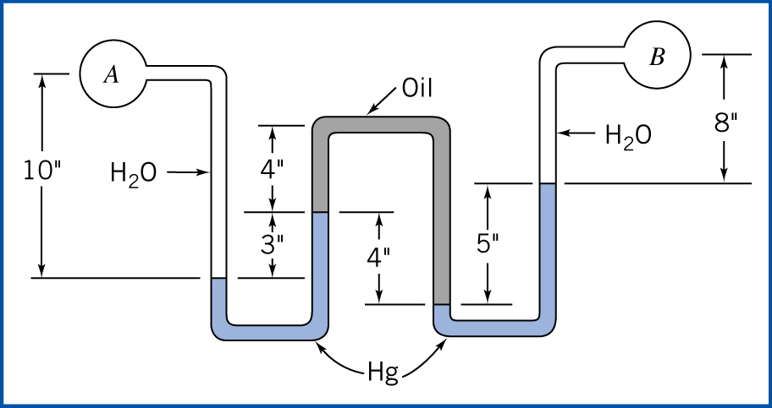
Multiple-liquid manometer
Determine pressure difference p_{A} – p_{B}
SG (Hg) = 13.6, SG(oil) = 0.88

Slide 17



Pressure variation in a static fluid - Gases
Compressible fluid – Ideal gas
US standard atmosphere (T = fn(z) upto 11 km))

Slide 18
Hydrostatic forces on submerged surfaces
Resultant force acting on a submerged surface in a liquid
Magnitude of the force
Direction of the force
Line of action of the force
Submerged surfaces
Plane surface
Curved surface

Slide 19
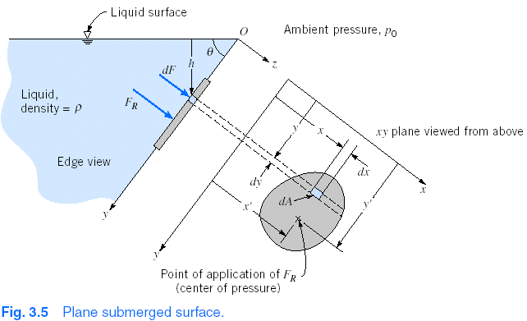
Hydrostatic forces on submerged surfaces
Plane submerged surface

Slide 20

Hydrostatic force on plane submerged surface
Integral equations – Resultant force
Magnitude of the force
Direction of the force
Perpendicular to the plane surface

Slide 21

Hydrostatic force on plane submerged surface
Algebraic equations – Total pressure force
Magnitude of the force
Where p_{c} → absolute pressure at the centroid of the area
Direction of the force
Perpendicular to the plane surface

Slide 22

Hydrostatic force on plane submerged surface
Algebraic equation – Net pressure force
In the case when the same p₀(ambient or equivalent pressure) acts at the free surface and other side of the submerged surface
Magnitude of the force
Direction of the force
Perpendicular to the surface of the plane

Slide 23
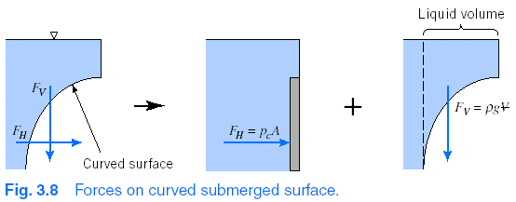
Hydrostatic force on curved submerged surface
Horizontal force = equivalent vertical plane force
Vertical force = weight of fluid directly above the surface (+ free surface pressure force)

Slide 24
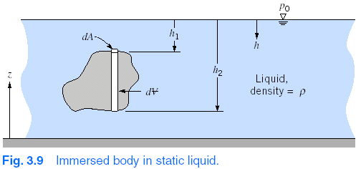



Buoyancy
If an object is immersed in a liquid, or floating on its surface, the net vertical force acting on it due to liquid pressure, is called buoyancy
Buoyant force of the fluid is equal to the weight of the displaced fluid (Archemedes’ principle)

Slide 25
Buoyancy/Weight
Direction of the buoyant force is vertically upwards
Line of action of the buoyant force
It passes through the centroid of the displaced volume
Center of buoyancy
Line of action of the weight of the body
Center of gravity

Slide 26
Stability
Stability of a body can be determined by considering what happens when it is displaced from its equilibrium position
Stable equilibrium position (of a body)
When displaced, it returns to its equilibrium position
Unstable equilibrium position
When displaced (even slightly), it moves to new equilibrium position
Lines of action (locations) of buoyant and gravity forces → Important to determine stability

Slide 27
Stability of completely immersed body
If CG (center of gravity) is below the CB (center of buoyancy)
Get restoring couple
Body is stable
If CG is above the CB
Get overturning couple
Body is unstable

Slide 28
Stability of a floating body
Depends on the geometry of the body, weight distribution
For a body like barge (that rides low in the water)
Stable configuration when CG is above the CB
For a slender (tall) body
Unstable configuration when CG is above the CB

